Slide 1
The Electronic Dispensing Tool FEATURES
Presented by: insert your name here

Slide 2
About The e-Dispensing tool
The Electronic Dispensing Tool (EDT)
A Microsoft Access 2010 software program running on Microsoft SQL Server 2008R2 database engine.
Used by the Namibia ART Programme to collect and manage pharmacy related data of patients on ART.
Currently in use at 50 public health facilities countrywide, including hospitals, health centres and clinics.
Has its mobile version - The EDT Mobile - which extends its reach to other primary health care facilities providing ART services.
Introduction

Slide 3
Definition of Terms
Patients Statuses
Lost Status - 30 days after missed Pharmacy appointment.
Loss To Follow Up Status (LTFU) - 90 days after missed Pharmacy appointment.
Main site
An ART services providing hospital, health centre or clinic with its own EDT computer.
Peripheral site
A neighbouring site (i.e. health centre or clinic), that does not have an EDT computer.
Introduction

Slide 4
Using the EDT to improve ART service delivery
Patient Management at main site using the EDT
Entering patients on ART from other sites
Stock Management at main site using the EDT
Main site ART processes
Patient Management at peripheral site using the EDT Mobile
ART Reporting and Data Quality using EDT reports
Stopping patient management on the EDT
Updating patient data
Recording stock take details
Peripheral site ART Process flow
Dispensing to patients
Main site ART processes
Recruitment of new patients initiating ART
Reversing a transaction
Managing patient appointments
Receiving and Issuing of stock from the EDT
Quantification of ARVs
Preparing stock for peripheral site
Peripheral site ART Processes
Preparing the EDT Mobile
Dispensing
ART recruitment
Facility, regional, and national level
Using predfined EDT reports
Monitoring patient adherence to ART
Completing the ART Monthly Reporting Template at the main site
Improving EDT Data quality
ART Data abstraction, validation and use
Updating the main site
Introduction

Slide 5
Overview of the EDT
The EDT toolset comprises:
The EDT desktop application (the main tool)
EDT Reports desktop application (for generating reports)
EDT Mobile (data collection terminal)
EDT Printer (for printing medicine labels)
ART national database (NDB)
EDT 3G dongles (for electronic data transfer to the NDB)
Getting Started

Slide 6
Overview of the EDT
Additional tools used with the EDT toolset:
ART Monthly Reporting Template
ART Recruitment Form (for peripheral sites)
ARV Medicines Codes Leaflet
Medicines Leaflet for Stock Taking
Patient’s File (Patient Care Booklet)
Patient’s Passport
Getting Started

Slide 7
The main functions of the EDT
Patient Management
Dispense: used to dispense to existing patients and automatically calculate adherence by pill count
Patient View: used to manage existing patients
Patient Add: used to add new, transferred-in or in-transit patient
Appointments: used to manage patient appointments
Overview of the EDT

Slide 8
The main functions of the EDT
Stock/Medicines Management
Receiving stock: used to receive medicines into the system
Issuing stock: used to issue medicines to other sites
Medicines: view medicine details including dispensing, receiving, stock-take history, and quantification
Stock Take: used during stock taking to update stock levels
Quantification: view the recommended re-order quantities based on consumption
Overview of the EDT

Slide 9
The main functions of the EDT
Export/Import from the EDT Mobile
Creating files and sending them to the EDT Mobile
Receiving/importing files from the EDT Mobile
Verifying imported data
Overview of the EDT

Slide 10
The main functions of the EDT
EDT Reporting Module comprises the following reports run for a given period of time, usually monthly
New Patients Started on ART
No. of Pickups
All Patients: Active, LTFU, etc.
All Regimen Switches including substitutes
No. of Patients: Transferred-In, LTFU this month etc.
Patients late for appointment
Patient Adherence
Overview of the EDT

Slide 11
The main functions of the EDT
EDT Reports, continued
Current Stock Balances as of now
Medicines Dispensed by Period
Items presumed out of Stock
No. of Scripts per day
No. of Patients who ran out of ARVs by the time of the routine refill
Summary reports of Active Patients by Facility & Region
Etc.
Overview of the EDT

Slide 12
The main functions of the EDT
EDT Reports, continued, HIVDR EWIs
Retention in Care after 12 months (EWI2)
% of patients retained on 1st line therapy at 12 months for a selected cohort
% of patients LTFU at 12 months for a selected cohort
On-time Pill Pickup & Dispensing Practices (EWI1&4)
% of patients picking up their ARVs on time for a selected cohort
% of patients started on an appropriate 1st line regimen
% of patients exhibiting >75% adherence based on pill count
Overview of the EDT

Slide 13
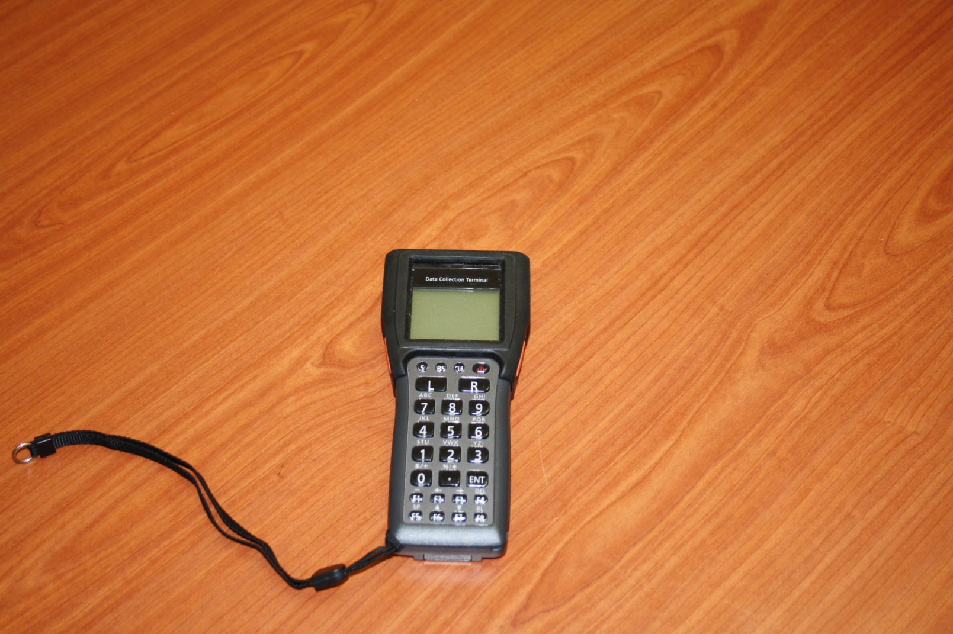
EDT Mobile
Overview of the EDT

